Slide 1
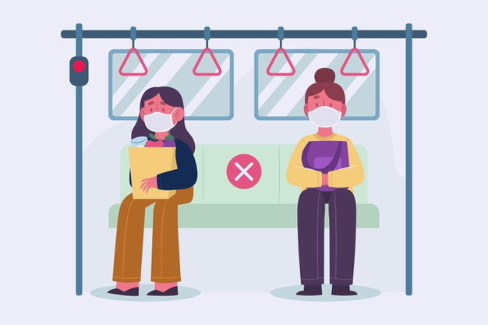
18CSC206J-SEPM PROJECT 2MCAM
AISHWARYA B - RA1911003010020
VANDANA RAJESH - RA1911003010030
POOJA RAVI - RA1911003010033

Slide 2
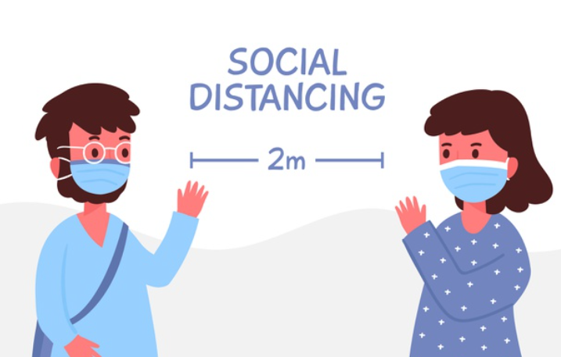
WHAT IS SOCIAL DISTANCING?
Now that the coronavirus and COVID-19, the illness it causes, are spreading among communities in several countries, phrases such as “physical distancing,” “self-quarantine” and “flattening the curve” are showing up in the media.

Slide 3
Problem statement of project 2[M]CAM:
The practice of social distancing signifies maintaining a distance of 6 feet or more when in public places or simply staying at home and away from others as much as possible to help prevent spread of COVID-19.
The practice of social distancing encourages humans to maintain 2 metres/6 feet distance between themselves or even the use of online/video based communication and phone calls instead of in-person contact.
As communities reopen and people are more often in public, the term “physical distancing” (instead of social distancing) is being used to reinforce the need to stay at least 6 feet from others, as well as wearing face masks.

Slide 4
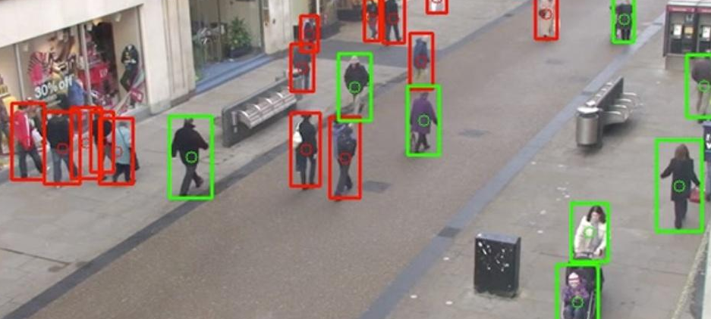
How will it work?
An image input or the frame of a video will be fed as the input to a function. The object detection algorithm will detect the presence of humans in the frame.
The distance between the centroid points of 2 identifiable human beings will be calculated. This distance is passed through a comparison metric which verifies if the distance is greater than 6 feet or 2 metres.
Finally, a green/red bounding box is drawn over the individuals in the frame to approve or flag the distance between them.

Slide 5
Use-cases of our application:
It will help us maintain social distancing,remind people to wear their mask in public.Will restrain the spread of corona.
It will inform the authorities if people are breaking norms.It will prevent workstations from becoming a hotspot.
It is easy to use and will be efficient. It can run on various platforms and is easy to set up.

Slide 6
Potential limitations we might face:
This application requires a working webcam for implementing the proof of concept.
It poses difficulties due to the fact that the organization needs to place cameras in specific spots to ensure appropriate results.
There is a possibility that we lack the computational resources like GPUs with higher configurations to perform different operations on videos and images.
Stereo vision camera cannot be used. Even though its very accurate than OpenCV, the engineering involved is very complex and expensive.

Slide 7
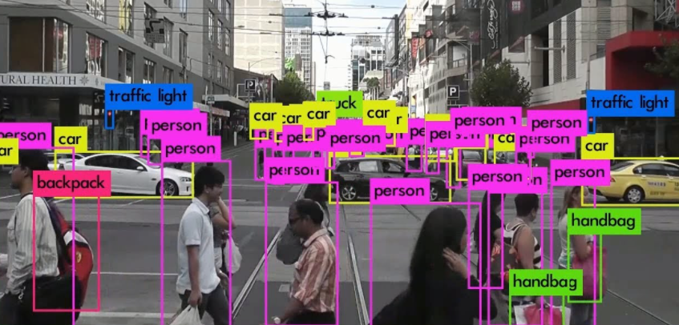
What is the approach employed in our project?
Installation of cameras at various workplace environments to monitor and ensure that employees and customers maintain social distancing.
Use Computer Vision technology to perform object detection and identify potential violations of the social distancing norms.
The identified humans are then put into bounding boxes. A distance metric calculates the distance of separation between 2 individuals.

Slide 8
Benefits of social distancing detection:
Reassuring Employees
Utilising Space
Monitoring & Measuring
Queue Monitoring

Slide 9
Strategic business context
Business Need
The goal of this application is to monitor and ensure social distancing among employees and customers especially in areas that can easily be crowded for eg. public spaces, waiting rooms, restaurants, etc. This application, in its essence, flags individuals who violate the social distancing norms.
Business Outcomes
Though vaccines are coming our way, it is always better to be safe than sorry. So, the major purpose of building such an application is to ensure the safety of workers and customers without having to manually control the crowd and direct each member to follow the guidelines. Having such an automated application helps authorities easily identify such violations and correct them.

Slide 10
ASSUMPTIONS
The required equipments are in good condition
Proper angle of webcam
Access to unlimited resources for using webcam throughout the day
Handling wifi related requirements

Slide 11
Dependencies
1. OpenCV - helps in accessing the webcam and display text on image or video
2. Tensorflow - Machine Learning framework
3. Numpy - in built mathematical python library
4. Streamlit- connect ML model to a web application and host it
5. Imutils - used for image operation a.k.a image preprocessing

Slide 12
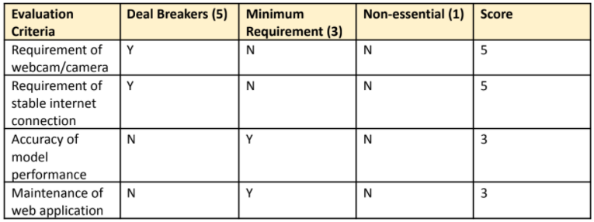
Requirements analysis

Slide 13
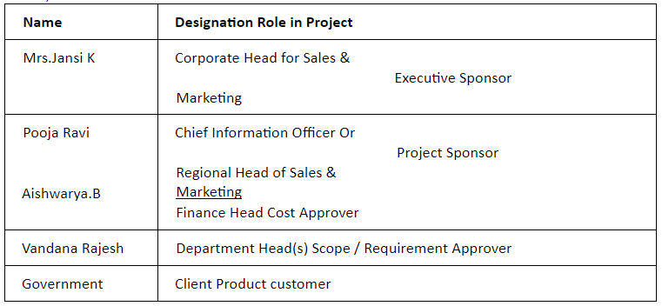
Stakeholder analysis

Slide 14
Project modules
MODULE | DESCRIPTION
Module-1- Object Detection Algorithm | Build a fully functioning object detection algorithm and ensure that it identifies a human being in the frame.
Module 2 - Social distancing detector | Build a social distancing detector and ensure it works on all test cases.
Module 3 - Web application | Build a web application by integrating the Machine Learning module.

Slide 15
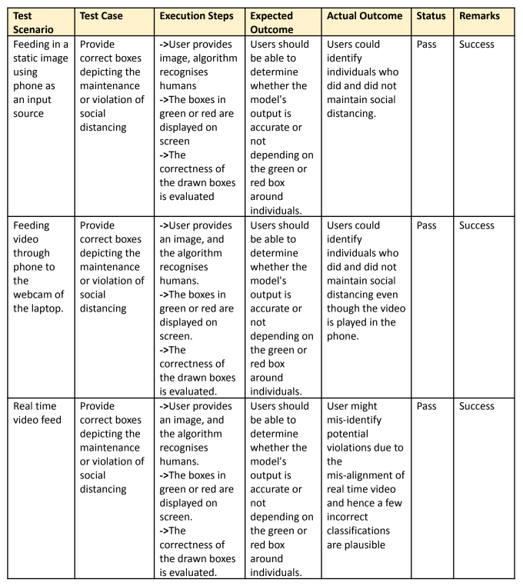
FUNCTIONAL TEST CASES

Slide 16
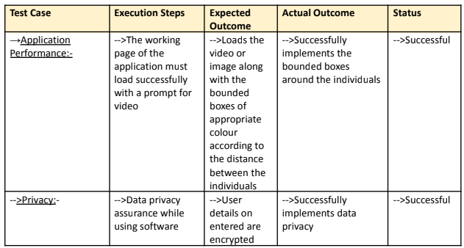
NON FUNCTIONAL TEST CASES

Slide 17
Risk analysis
Risk 1:
The usage of webcam or a separate camera might lead to violation of privacy in certain scenarios.
Risk 2:
The software may be prone to hacking-related threats and might hence have to compromise on video footage security.
Risk 3:
The maintenance of computational resources for running such applications continuously might become expensive.

Slide 18
RISKS
RISK DESCRIPTION | RISK CATEGORY [low/ medium/ high]
The usage of webcam or a separate camera might lead to violation of privacy in certain scenarios. | High Accept
The software may be prone to hacking-related threats and might hence have to compromise on video footage security. | Medium accept
threats and might hence have to compromise on video footage security | Low accept

Slide 19
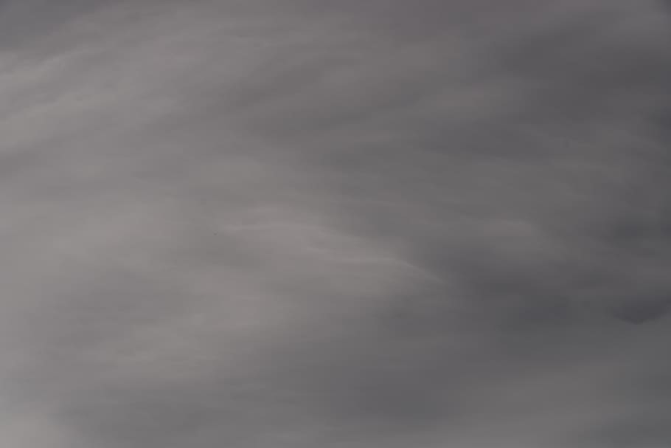
PROJECT CHARTER
Project Scope | To calculate the distance (in metres or feet) between various individuals and detect whether social distancing is being maintained or not.
Project Schedule | To achieve the milestones on or before the given dates and successfully submit the working prototype by the end of the session.
Constraints | This application requires a working webcam for implementing the proof of concept. It poses difficulties due to the fact that the organization needs to place cameras in specific spots to ensure appropriate results.
Intangible Benefit | Social benefits to prevent spread of disease. Brand values will grow exponentially. Government recognition for usage in public spaces.

Slide 20
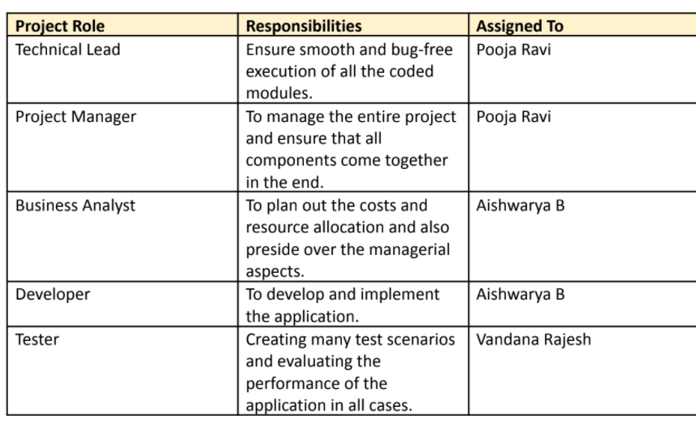
ROLES AND RESPONSIBILITIES:

Slide 21
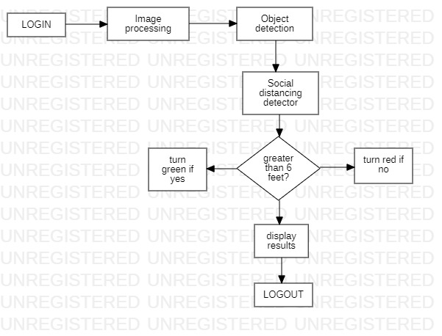
ARCHITECTURE DIAGRAM

Slide 22
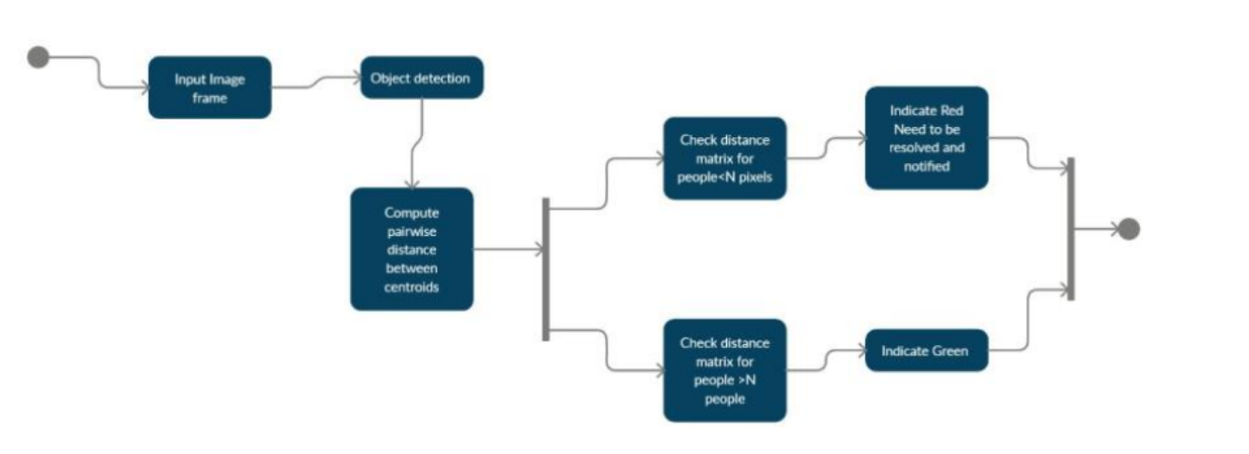
STATE DIAGRAM

Slide 23
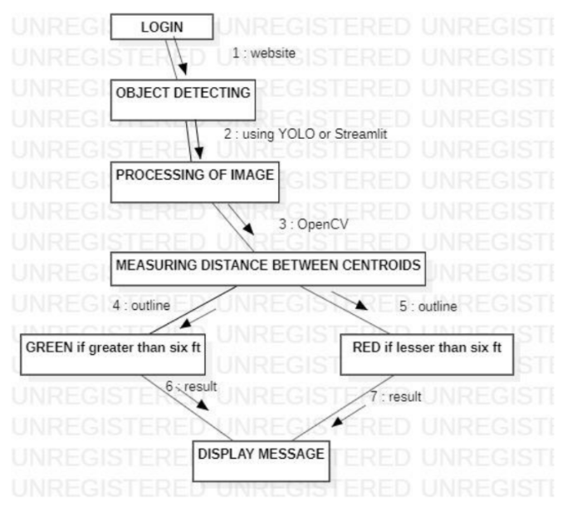
COLLABORATION DIAGRAM

Slide 24
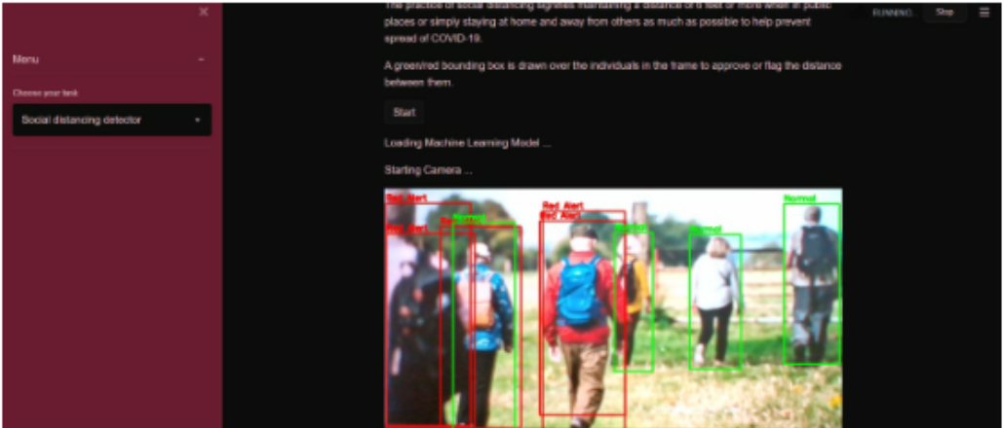
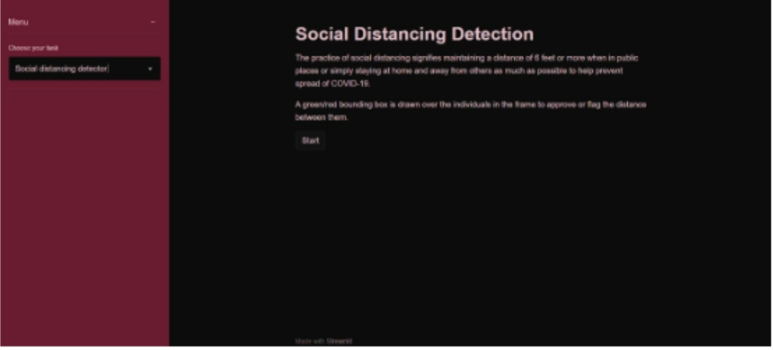
Results of the implementation- Demo

